Slide 1
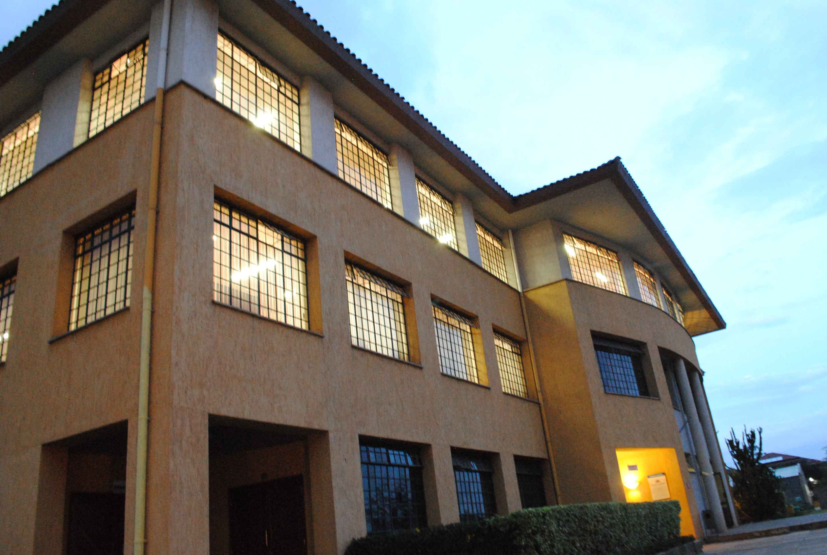


HED 1101
PHILOSOPHICAL ANTHROPOLOGY
CORPOREAL life
Notes:
Please check this notes pane for comments to some slides

Slide 2
Intended Learning Outcomes
By the end of this lecture, you should be able to:
Discuss the notion of life
Explain the characteristics of living beings from a philosophical perspective.
Identify the three levels of life.
Discuss the distinctive characteristics or powers of the three levels of life.
Explain the substantial unity of body and soul in living things.
Discuss the notion of the soul.

Slide 3
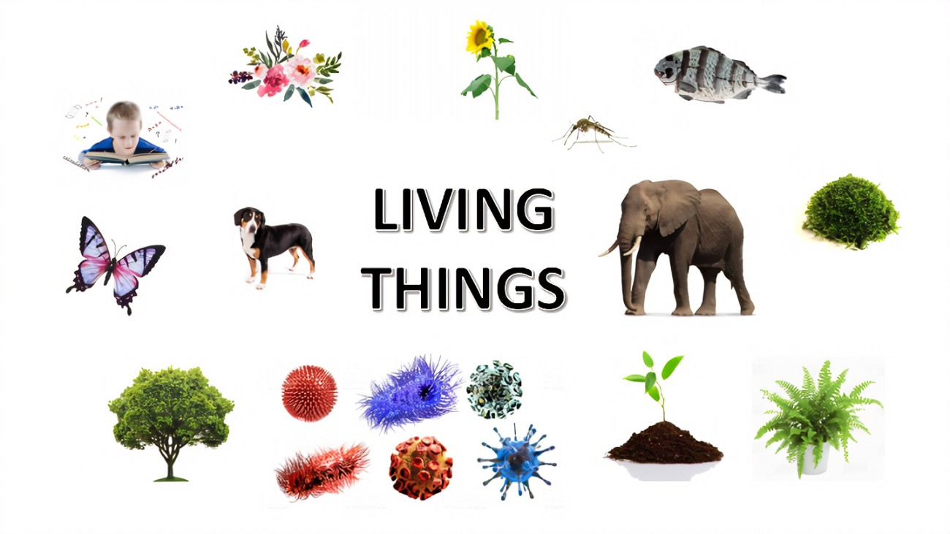
CORPOREAL LIFE
Living Beings
Notes:
Man is a living corporeal being hence we shall look at some basic philosophical concepts regarding life

Slide 4
Readings
Mimbi- 3.1 OR p. 67-69
Lombo & Russo- Chapter 2; No. 1-3 OR p. 27-35
PHILOSOPHICAL ANTHROPOLOGY
CAT 1
Question 1
What do Philosophy and Covid-19 have in common?
You can gerrit, I can gerrit, anybody can gerrit!
Notes:
At the beginning you may find readings in PA difficult because you are not familiar with philosophical concepts.

Slide 5
Corporeal beings
Living beings
Plant kingdom
Animal kingdom
Notes:
The concepts that we shall discuss apply to all corporeal life

Slide 6

Think, pair, share: Characteristics of Living Beings from Biology?

Slide 7
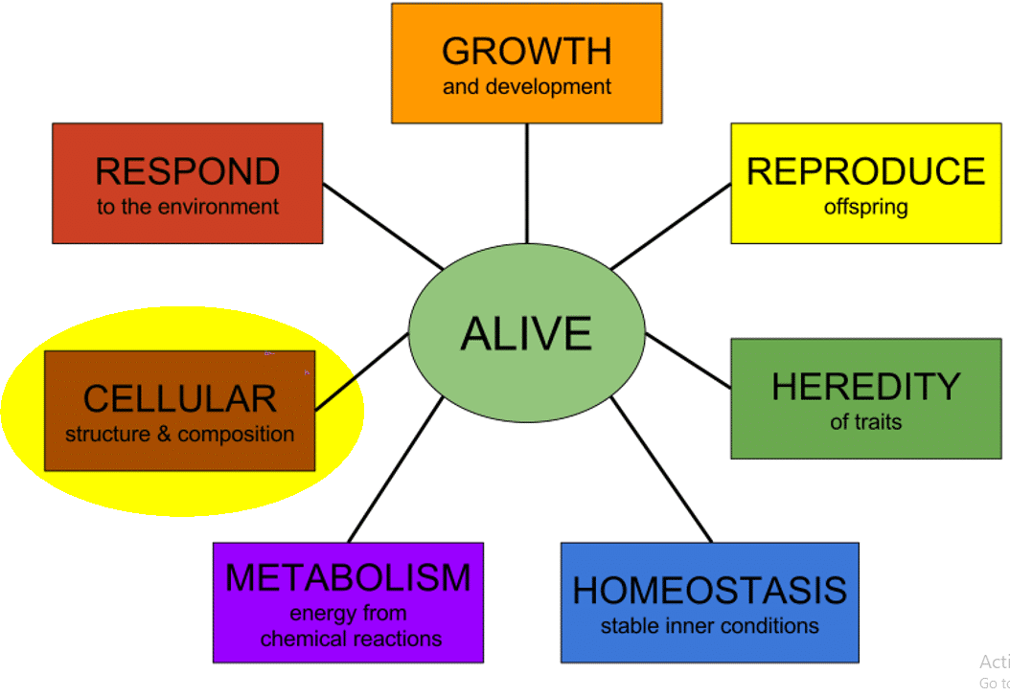
Notes:
From the perspective of the biological sciences…

Slide 8
Living Beings: General characteristics
Unity
Organicity
Self-movement
Self-fulfilment
Rhythm
Immanence
Transcendence
And…
Notes:
From a philosophical perspective…

Slide 9
1. Unity
Living things have unity
Harmony in the different parts of the being
Hence, living beings are physically stable
Life implies unity (disunity= death)
Division is incompatible with the life of the same individual

Slide 10
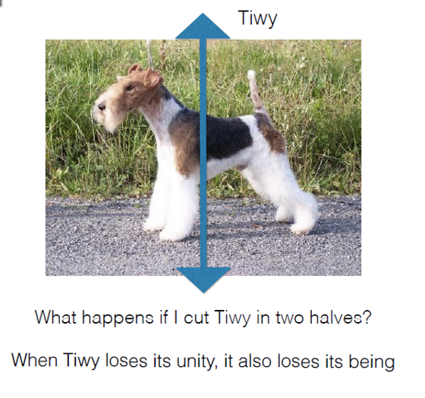
Notes:
Disunity= death

Slide 11
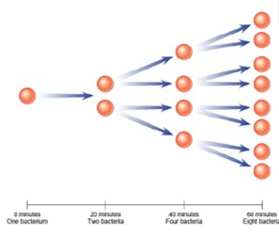
Notes:
Division is incompatible with the life of the same individual

Slide 12
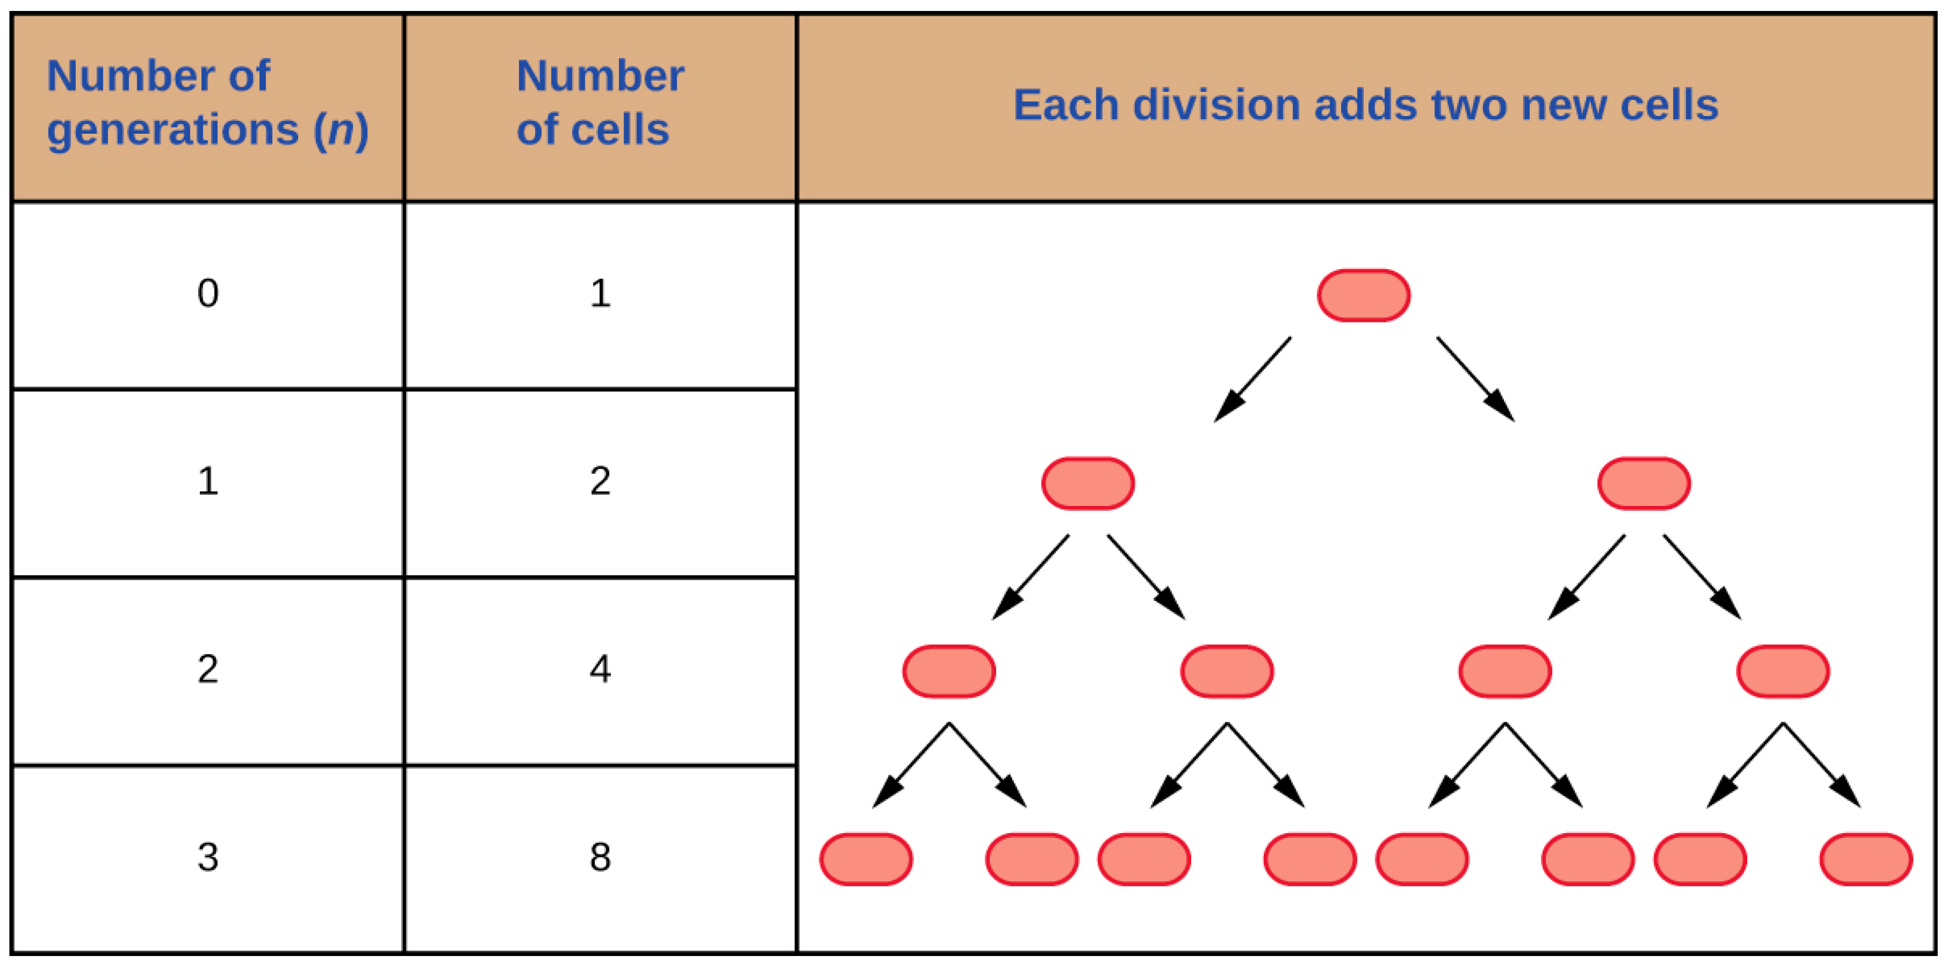
Notes:
Division is incompatible with the life of the same individual

Slide 13
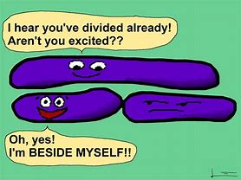
Notes:
Division is incompatible with the life of the same individual

Slide 14
2. Organicity
Living things are organic beings
Living beings are made up of differentiated parts/organs united into a systematic whole
The parts of a living being are intrinsically united
Each part of a living being has a different function
Each part functions for the benefit of the whole

Slide 15
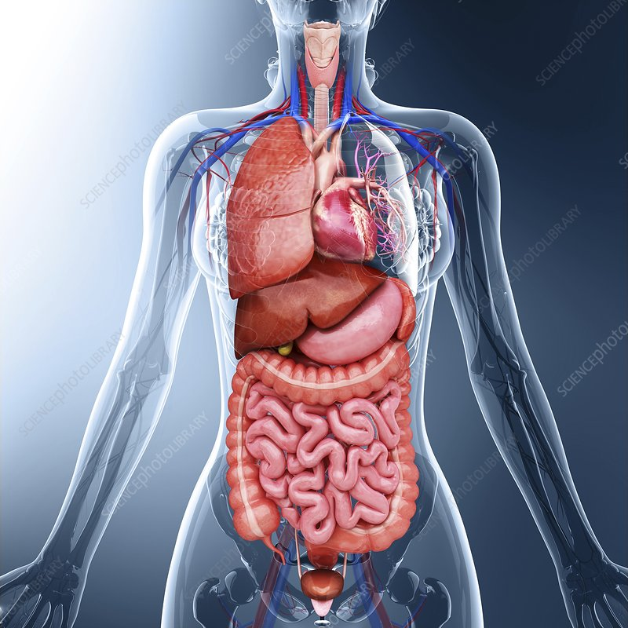

Slide 16
3. Self-movement
Living beings have the capacity for self-movement
This is the ability of a being to:
Act by itself
Undertake an activity starting from itself
Self-movement in living beings differs from that of machines/robots.
The origin of movement in a robot is not intrinsic to the robot; it does not lie in the robot itself but in the engineer who built it.
On the other hand, the origin of movement in living things is intrinsic to each living being; it comes from the “nature” of the living being.

Slide 17
4. Self-fulfilment
Living things tend towards self-fulfillment
Growth
Physical
Development (in the case of man)
Psychological and personal

Slide 18
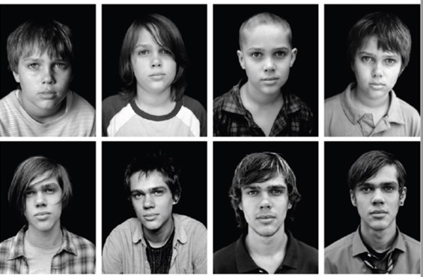

Slide 19
5. Rhythm
Living things undergo different cycles of life or patterns of events
Generation, growth, death
Nutrition, respiration, reproduction, etc.

Slide 20
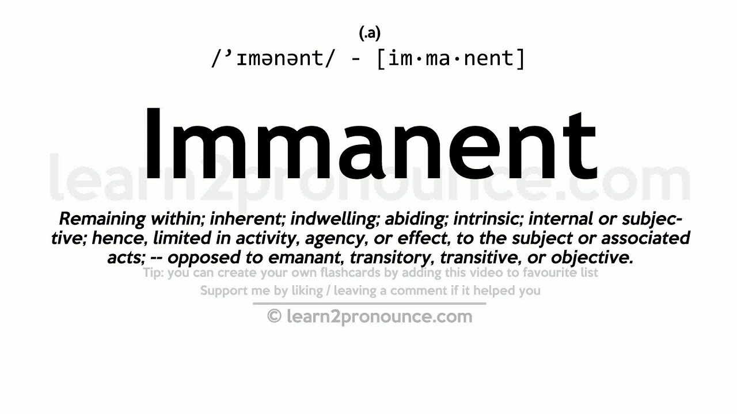

Slide 21
6. Immanence
The actions of living beings always remain within the agent that accomplishes them.
The activity of a living thing has an impact on the living thing itself. OR
The operations of a living thing will produce effects on the living thing itself
E.g., an act of nutrition will impact the body/remain in the body in the form of muscle, fat, etc.
Acts of lying will impact a person/remain in the person in the form of a vice-liar (a person who tells lies= a liar)
Notes:
Obviously, living things carry out actions that impact other beings. The point we are making here is that all actions of a living being have an impact on the acting being first and foremost.
When a lion kills an antelope, it is obviously having an impact on the antelope called death. however, it is simultaneously having an impact on itself so that we say that the lion is a predator.
When a young man/woman watches porn in secret, that action will obviously have an impact on his/her relationships. However, the act simultaneously impacts him/herself so that we say s/he is a ….
Nonetheless, please recall that actions, and qualities that result from the repetition of actions are accidental forms of being. Therefore, unfortunately, an injured lion may start eating carcasses and fortunately, a person who watches porn can find other ways to feel secure/loved or channel their aggression.

Slide 22
7. Transcendence
Living beings have the capacity to overcome the limits of existence through action
Transcendence is opposed to the limitedness of non-living beings.
Living beings are open to other reality
Transcendence is opposed to the closure of non-living beings.
Nutrition is a sign that plants are open to nutrients
Sensation is a sign that animals are open to stimuli
An act of kindness is a sign that man is open to others

Slide 23
CORPOREAL LIFE
Levels of Life

Slide 24
Readings
Lombo & Russo- Chapter 2 No. 4 OR p. 36-38
Mimbi- p. 70-72
PHILOSOPHICAL ANTHROPOLOGY
CAT 1
Question 1
What do Philosophy and Covid-19 have in common?
You can gerrit, I can gerrit, anybody can gerrit!

Slide 25
Think, pair, share: What characteristics distinguish plants from rocks?

Slide 26
Think, pair, share: What characteristics distinguish animals from plants?

Slide 27
Think, pair, share: What characteristics distinguish man from animals?

Slide 28
Being | Characteristics
Plant | Nutrition, growth and reproduction
Animal | Nutrition, growth and reproduction Movement from A to B Sensation Sense knowledge Response to stimuli (automatic)
Human | Nutrition, growth and reproduction Movement from A to B Sensation Sense knowledge Response to stimuli Intellect intellectual knowledge Free will

Slide 29
Level of Life (Degree of life) | Powers/Functions/Faculties
Vegetative Life | Nutrition, growth and reproduction
Sensitive Life | Nutrition, growth and reproduction Movement from A to B Sensation Sense knowledge Response to stimuli (automatic)
Intellectual Life | Nutrition, growth and reproduction Movement from A to B Sensation Sense knowledge Response to stimuli Intellect Intellectual knowledge Free will

Slide 30
Levels/Degrees of Life
Intellectual life
> vegetative + sensitive + intellectual powers
Sensitive life
> Vegetative + sensitive powers
Vegetative life
> Vegetative powers

Slide 31
CORPOREAL LIFE
Unity of
Body and Soul

Slide 32
Readings
Lombo & Russo- Chapter 4 No. 4 & 5
PHILOSOPHICAL ANTHROPOLOGY
CAT 1
Question 1
What do Philosophy and Covid-19 have in common?
You can gerrit, I can gerrit, anybody can gerrit!

Slide 33
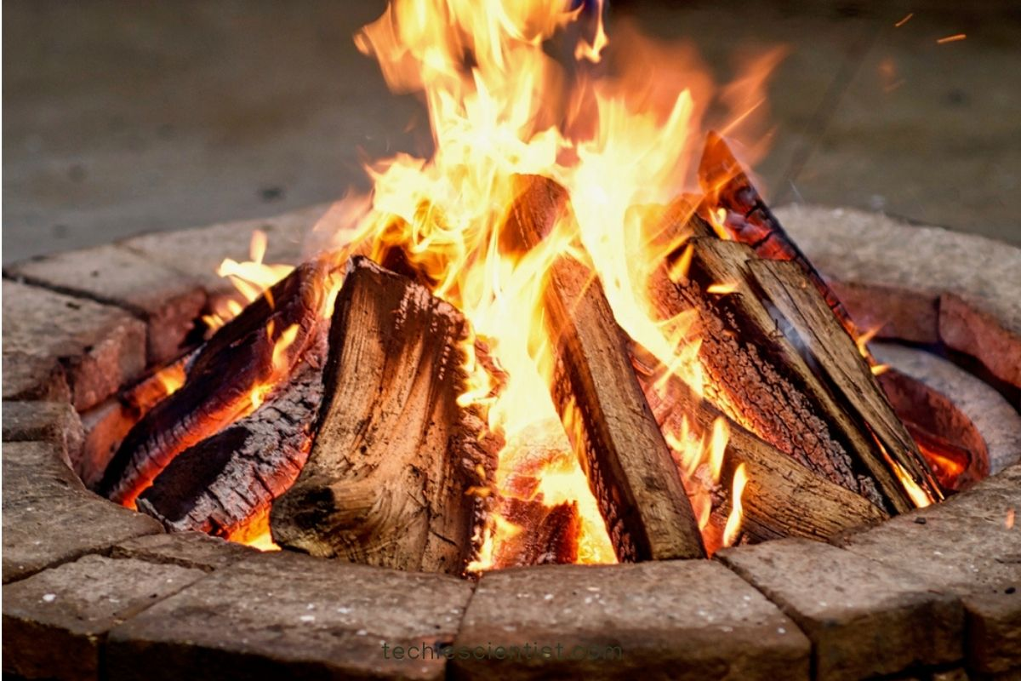
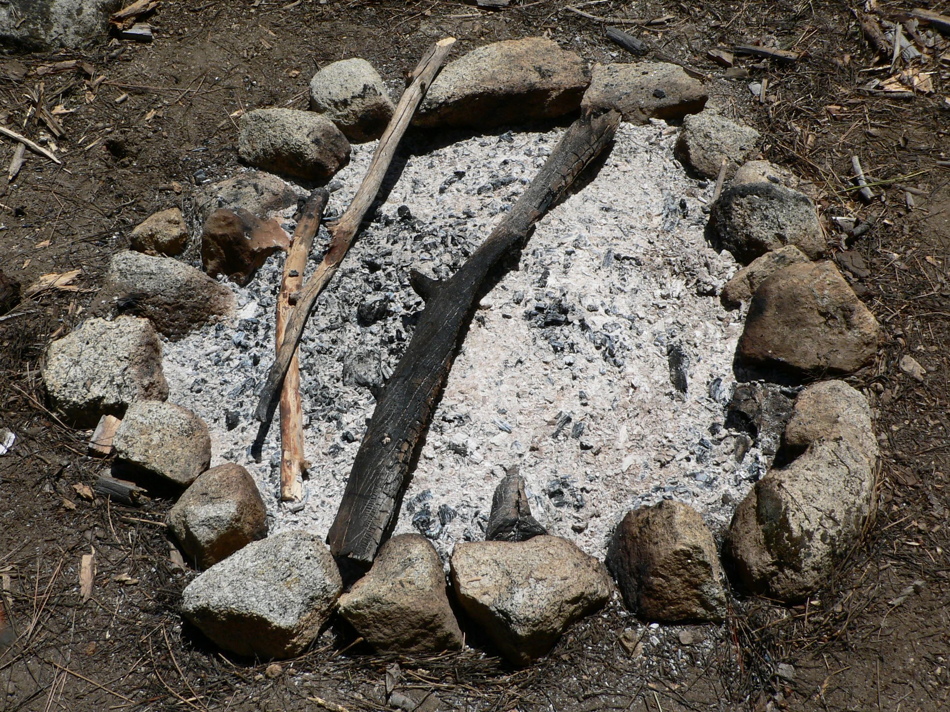
Recall what we learn from substantial changes
We learn that corporeal beings are composed of:
Substantial Form (Woodness/Ashness)
and
Prime Matter
E.g.;
Prime matter is what remains constant when we have a change in the substantial form of a given reality from wood to ash.

Slide 34
Corporeal Living Beings (C.L.B)
A C.L.B is a unity of body & soul (Matter & Form)
Not just a body = corpse. C.L.B ≠ a body
Not just a soul = form. C.L.B ≠ a soul
Not just having a body. C.L.B ≠ a soul with a body
Important note:
The body is not an accident: the body is a co-principle of a C.L.B.
The accident is quantity= extension, size or volume.
A living being is one being/one substance
Death= separation of body and soul in living beings
(All C.L.B die/are mortal/are not immortal)

Slide 35
CORPOREAL LIFE
The Soul

Slide 36
Readings
Lombo & Russo- Chapter 3
PHILOSOPHICAL ANTHROPOLOGY
CAT 1
Question 1
What do Philosophy and Covid-19 have in common?
You can gerrit, I can gerrit, anybody can gerrit!

Slide 37
Think, pair, share: What is the Soul?

Slide 38
What is the Soul?
Definition 1
The soul is the substantial form of a living thing
The form that actualizes matter in living beings
Being
Act of Being
Manner of Being
Substantial Form
Prime Matter

Slide 39
What is the Soul?
Definition 2
The soul is the principle of life in living things
(The soul is the source of life in living things)
X has the characteristics
of life
X has a Soul

Slide 40
What is the Soul?
Definition 2
The soul is the principle of life in living things
(The soul is the source of life in living things)
Hence, we can speak of:
The soul of a plant> vegetative soul
The soul of an animal> animal soul
The soul of man> human soul

Slide 41
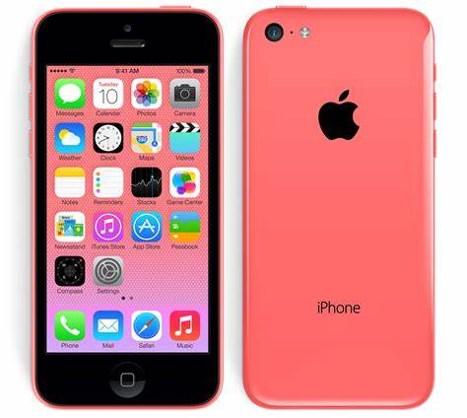
Notes:
Though your smart phone is not a living being, it can serve as an analogy for the unity between body and soul in living things.
What are the components of a working phone?
>Hardware and software make up a working phone> body and soul make up a living being
The programs in your phone “give life” to your phone’s hardware> because of its software, your phone functions or does things.
The soul give life to your body> because of the soul, you function or do things

Slide 42


Notes:
*****FYI*****
Know what this is?
>The blackberry was the best high-end phone in the market in the year 2000 (just before you were born)
>> All the who-is-who used to flash out their blackberries for all to see (just like some iPhone users today ;-))
The first iPhone was released in 2007 and soon took over the high-end phone market
Why did the blackberry fail?
>Failure to upgrade its OS and look (software and hardware).
> It supported limited apps
The soul of a living thing determines the scope of its powers/functions/activities
A plant cannot carry out sensitive functions e.g., to see or to feel fear because its life-giving principle (its vegetative soul) is not rich enough to support those functions. It would need a being with a level of life higher than itself to upgrade it to the animal level of life.
Similarly, an animal cannot carry out intellectual functions e.g., write code, or marry you because its life-giving principle (its animal soul) is not rich enough to support those functions. It would need another being with a level of life higher than itself to upgrade it to the human level of life.

Slide 43
What is the Soul?
The principle of life in living things
> It determines a living thing’s level of life
Intellectual life
> vegetative + sensitive + intellectual functions
> Human soul
Sensitive life
> Vegetative + sensitive functions
> Animal soul
Vegetative life
> Vegetative functions
> Vegetative soul
Notes:
The richer/more intense the soul of a living thing, the higher the functions it performs/the greater its powers.
*************
The higher the OS and version of apps, the higher the functions a phone performs

Slide 44
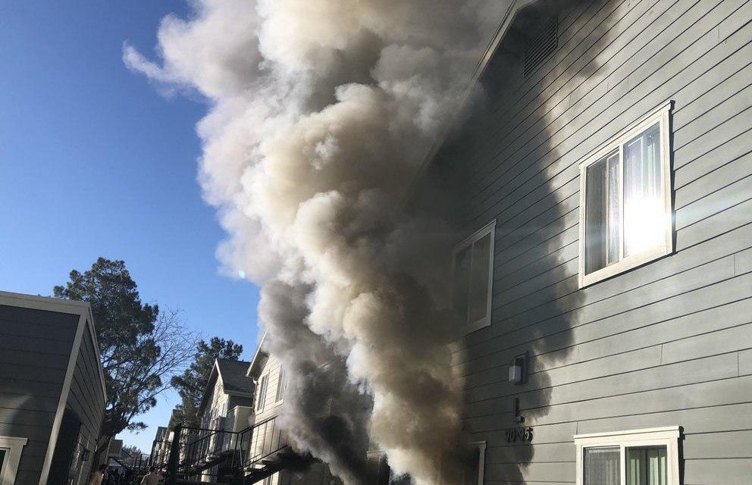
Describe this picture using a proverb/idiomatically…
Notes:
Where there is smoke there is fire
When you see smoke, you understand that it is being caused by a fire even if you cannot see the fire.
You may not see the code in your phone, but you know it is the cause of the activity of your phone.
Likewise, we understand that there must be a cause for the distinction between living and non-living beings. That cause is what we call soul in philosophy. The soul is the ultimate cause of the activities/functions of living beings.
While the activity of a living being can be investigated using the scientific method, its soul is inaccessible to the method as it is a metaphysical reality.

Slide 45
What is the Soul?
Definition 3
The soul is the first principle of operations in living things
(The soul is the first source of activity in living things)
E.g.,
The power of sight is the immediate principle/source of the operation/act of seeing.
However, the power of sight is caused by the substantial form.
Therefore, the substantial form/the soul is the first principle of the act of seeing in all beings that see.

Slide 46
Characteristics of the Soul
The soul is simple; i.e., it has no parts.
The soul is incorporeal; i.e., it is not a body.
It translates the potency of matter into act and makes it an organized whole, but of itself it is not identified with the body nor with a part of the body (the brain, the heart, etc.).
Notes:
Because the soul is simple and incorporeal, it cannot be split. Splitting is a thing of matter so to speak.

Slide 47
Characteristics of the Soul
The soul has no extension
Extension is a property of matter but not of form per se.
Hence, the soul cannot be measured or weighed nor have its location in a specific organ of the body.
The soul is unique, i.e., only one soul per C.L.B
Since there is only one substantial form in each substance, likewise there is only one soul in each living being.

Slide 48

Time to sharpen your critical thinking skills! Class Activity- To be or not to be 2
Notes:
See the e-learning platform

Slide 49
Intended Learning Outcomes
By now you should be able to:
Discuss the notion of life
Explain the characteristics of living beings from a philosophical perspective.
Identify the three levels of life.
Discuss the distinctive characteristics or powers of the three levels of life.
Explain the substantial unity of body and soul in living things.
Discuss the notion of the soul.

Slide 50

Topic 2- Part 2
Notes:
Thank you!

